Slide 1
"Unit 10: "For Live Session"
Chad Madding

Slide 2
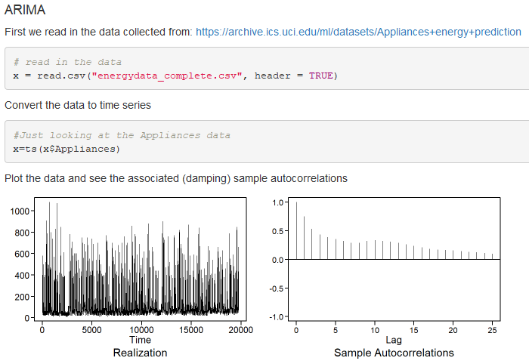
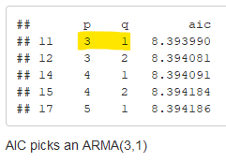
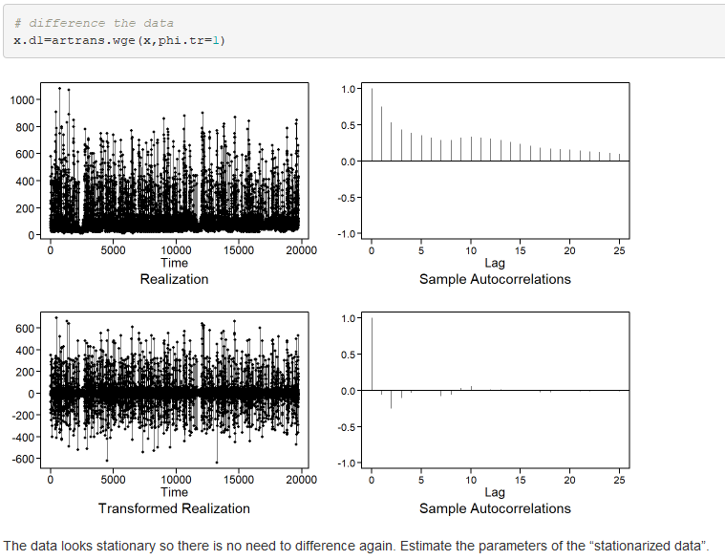
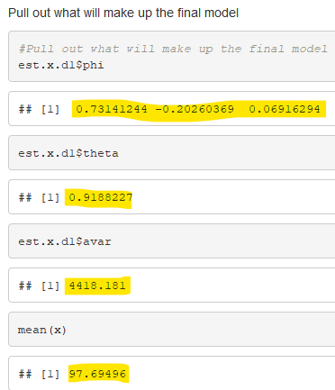
Select a data set, and complete one of each model ID below:

Slide 3
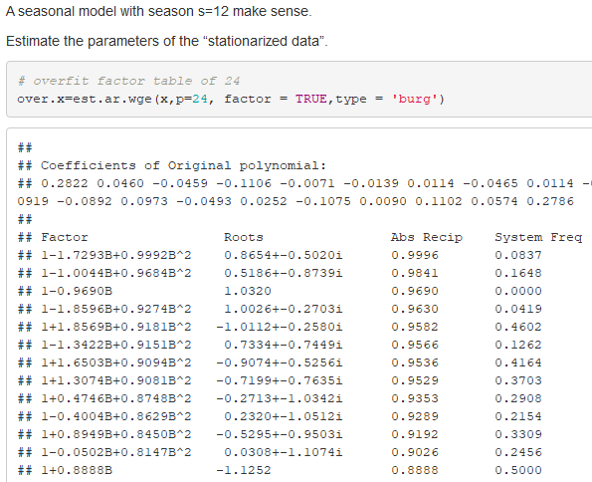
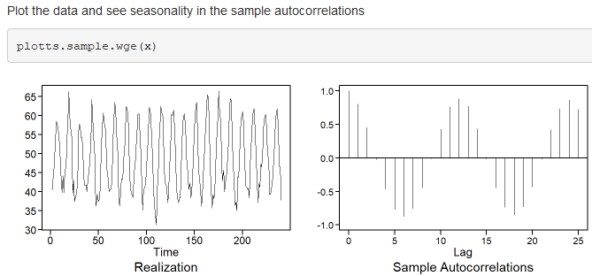
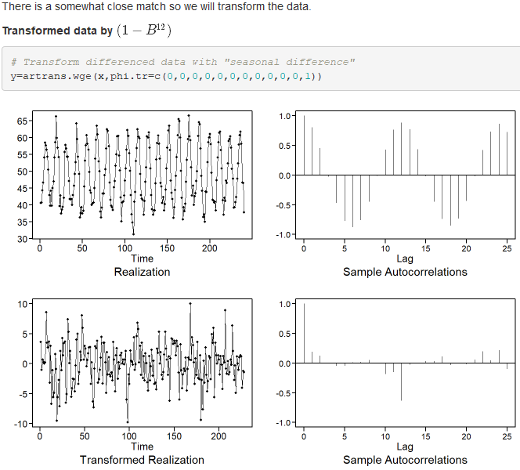
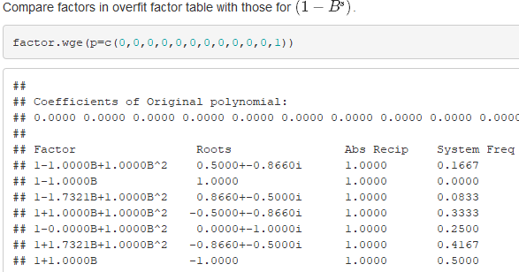
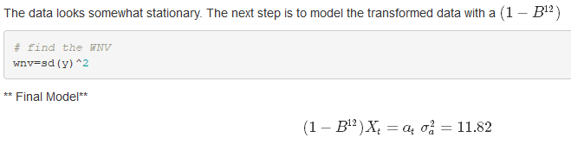
Select a data set, and complete one of each model ID below:
Seasonal

Slide 4
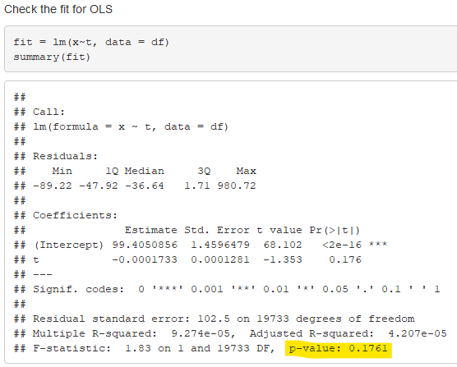

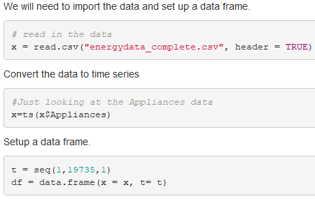
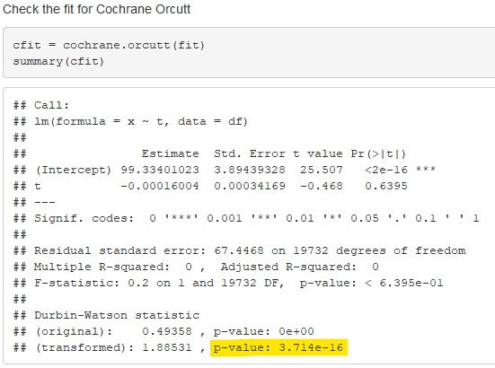
Select a data set, and complete one of each model ID below:
Signal Plus Noise with Cochrane–Orcutt

Slide 5
Select a data set, and complete one of each model ID below:
Take your time series, and analyze it with these methods

Slide 6
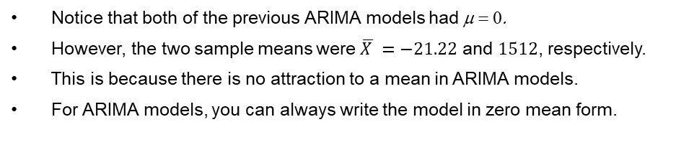
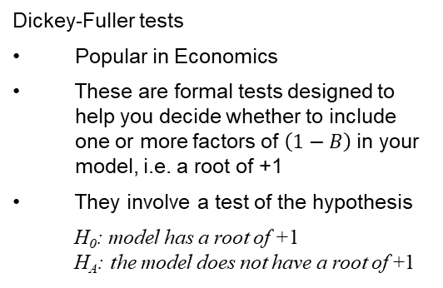
A brief reflection of thoughts and key takeaways – Week 10
Notice that both of the previous ARIMA models had μ = 0.
However, the two sample means were $\overline{X }=−21.22$ and 1512, respectively.
This is because there is no attraction to a mean in ARIMA models.
For ARIMA models, you can always write the model in zero mean form.
Dickey-Fuller tests
Popular in Economics
These are formal tests designed to help you decide whether to include one or more factors of $\left(1−B\right)$in your model, i.e. a root of +1
They involve a test of the hypothesis
H₀: model has a root of +1 H_{A}: the model does not have a root of +1
Box-Jenkins approach for detecting and removing stationarities
If data are wandering and sample autocorrelations damp slowly
Difference the data
If differenced data still show evidence of a unit root
Difference the data again, etc.
Result (Tiao/Tsay) (loosely stated):
If a high order AR(p) model is fit to a realization from a nonstationary model with roots on the unit circle, then factors associated with these roots will “show up” in the factor table.
The nonstationary behavior will “show up” in factor tables for a wide range of orders p.
Fitting several high order models to a set of data to identify nonstationarities is called overfitting.
Question: I understand how to use the Cochran-Orcutt but I never saw how to build a model from the Signal Plus Noise. What are the steps for building a Signal Plus Noise model?

